Slide 1






Enhanced environmental protection inspection for efficient control of air quality monitoring and of all entities under obligation within system of greenhouse gas emission allowance trading, in order to achieve better quality of air in Republic of Croatia
This project is funded by the European Union

Slide 2



11: INSPECTION MONITORING
Energy research and Environmental Protection Institute

Slide 3
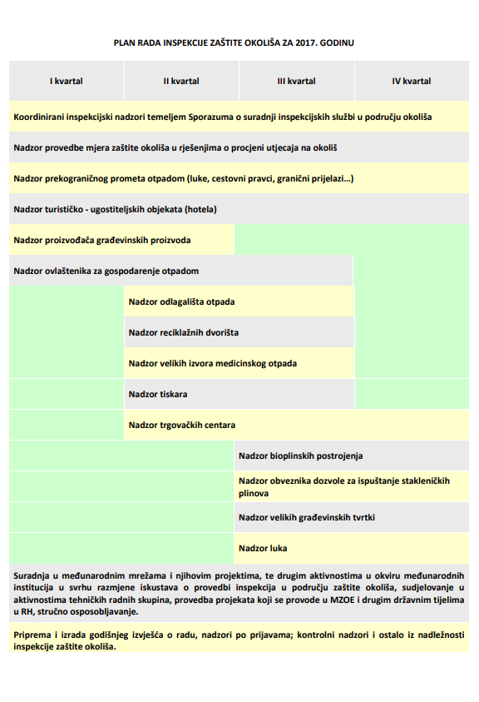
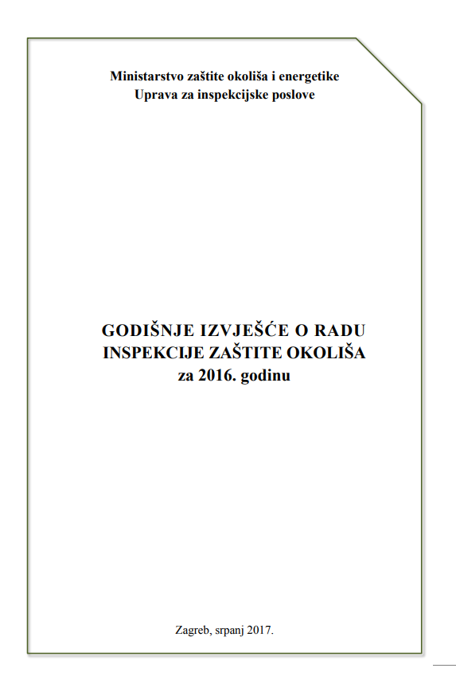
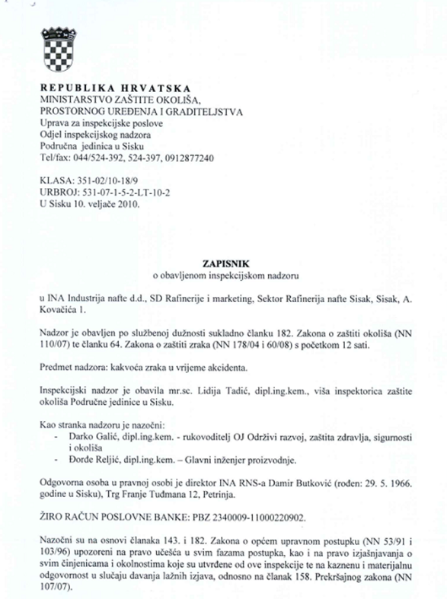

11.6 RMCEI – EXAMPLES FROM PRACTICE
European Union IPA 2013 Programme for Croatia
Institut za energetiku i zaštitu okoliša
Energy Research and Environmental Protection Institute

Slide 4
11.6 RMCEI - EXAMPLES FROM PRACTICE
European Union IPA 2013 Programme for Croatia
What is „RECOMMENDATION OF THE EUROPEAN PARLIAMENT AND OF THE COUNCIL of 4 April 2001 providing for minimum criteria for environmental inspections in the Member States”
These are recommendations that prescribe the harmonization of environmental inspections (ENVIRONMENTAL INSPECTION) in the EU Member States based on experience and knowledge of the European Union network for the implementation and enforcement of environmental law (IMPEL).
These recommendations are also incorporated into the Environmental Protection Act.
Institut za energetiku i zaštitu okoliša
Energy Research and Environmental Protection Institute

Slide 5
11.6 RMCEI - EXAMPLES FROM PRACTICE
European Union IPA 2013 Programme for Croatia
Why were they adopted?
To ensure the best implementation of environmental regulations and to achieve minimum criteria for inspection in the EU.
Institut za energetiku i zaštitu okoliša
Energy Research and Environmental Protection Institute

Slide 6
11.6 RMCEI EXAMPLES FROM PRACTICE
European Union IPA 2013 Programme for Croatia
What is„ENVIRONMENTAL INSPECTION” - inspection in environmental protection?
These are all activities that involve compliance verification of EU regulations and / or regulations of the member states that was transposed from EU legal requiremenets in the field of environmental protection
Monitoring the impact of controlled installations on the environment to determine whether further action is required
Monitoring EU standards, checking documentation, and site space
Institut za energetiku i zaštitu okoliša
Energy Research and Environmental Protection Institute

Slide 7
11.6 RMCEI - EXAMPLES FROM PRACTICE
European Union IPA 2013 Programme for Croatia
What is„ENVIRONMENTAL INSPECTION” - inspection in environmental protection?
Application in Croatia
Inspection of environmental protection within its competencies carries out inspection of legal and natural persons over the application of the Environmental Protection Act, the Law on Air Protection, the Law on Sustainable Waste Management and the Act on the Protection of Light Pollution, and regulations passed under these laws regulating general environmental issues, air protection, waste and hazardous waste management, and light pollution protection. (ANNUAL REPORT ON THE WORK OF THE ENVIRONMENTAL INSPECTION FOR 2016)
Institut za energetiku i zaštitu okoliša
Energy Research and Environmental Protection Institute

Slide 8
11.6 RMCEI - EXAMPLES FROM PRACTICE
European Union IPA 2013 Programme for Croatia
Inspection of whom?
All those who have emissions into the environment (water, air, soil) and who need to be licensed under EU regulations for their work - we call them "CONTROLLED INSTALLATIONS"
Application in the Republic of Croatia
IZO (Inspection in environmental protection), within its scope of competence, monitors the obligation of legal and natural persons in carrying out environmental permit measures, solutions to integrated environmental conditions and environmental impact assessment, monitors emission sources of air pollutants, air quality and waste management, takes measures to remove adverse effects on the environment due to extraordinary events, monitors the quality of bathing water on the beaches, cross-border waste transport, treatment of substances that damage the ozone layer, the implementation of ratified international agreements and other matters within the scope of competence. (ANNUAL REPORT ON THE WORK OF THE ENVIRONMENTAL INSPECTION IN 2016)
Institut za energetiku i zaštitu okoliša
Energy Research and Environmental Protection Institute

Slide 9
11.6 RMCEI - EXAMPLES FROM PRACTICE
European Union IPA 2013 Programme for Croatia
Who can conduct an environmental inspection?
Each competent authority appointed by the EU Member State and assigned to
this area
Application in the Republic of Croatia
Article 224. of Environmental Protection Act
Inspection supervision of the application of this Act and regulations passed on the basis of this Act shall be carried out by civil servants in the Ministry assigned to workplaces with the authority to carry out inspections of environmental protection, unless provided otherwise by this Act.
Institut za energetiku i zaštitu okoliša
Energy Research and Environmental Protection Institute

Slide 10
11.6 RMCEI - EXAMPLES FROM PRACTICE
European Union IPA 2013 Programme for Croatia
Organizing Environmental Inspection
Each Member State shall ensure that an environmental inspection provides a high level of environmental protection and that monitoring of controlled facilities is organized and conducted in accordance with the same criteria and that the monitoring reports contain relevant information in accordance with the recommendations.
ANNUAL REPORT ON THE WORK OF ENVIRONMENTAL PROTECTION INSPECTION for 2016
2. GENERAL DATA ON INSPECTION OF ENVIRONMENTAL PROTECTION 4
2.1. Competence
2.2. Goals and prorities
2.3. Structure
2.4. Administrative capacities
Institut za energetiku i zaštitu okoliša
Energy Research and Environmental Protection Institute

Slide 11
10.5 RMCEI - planning - EXAMPLES FROM PRACTICE
European Union IPA 2013 Programme for Croatia
Plans for inspection in environmental protection
Each Member State shall ensure that the environmental inspection is planned in advance and that such plans cover monitoring of controlled installations throughout the territory of the Member State and that all inspection bodies carry out monitoring in the same way.
Inspections in the area of the environment are carried out in accordance with the annual plan and work program of the Environment Protection Inspection prepared pursuant to Article 227 of the Environmental Protection Act.
In order to perform coordinated monitoring, the annual plan and program is aligned with the annual plans and programs of other inspections.
Institut za energetiku i zaštitu okoliša
Energy Research and Environmental Protection Institute

Slide 12
10.5 RMCEI - planning - EXAMPLES FROM PRACTICE
European Union IPA 2013 Programme for Croatia
What should plans be based on?
EU regulations to be applied
the register of controlled installations and their compliance with EU environmental standards
assessment of major environmental threats
data on previous monitoring
Institut za energetiku i zaštitu okoliša
Energy Research and Environmental Protection Institute

Slide 13
10.5 RMCEI - planning - EXAMPLES FROM PRACTICE
European Union IPA 2013 Programme for Croatia
Plan for environmental protection inspection should contain at least following
geographic area it covers
the time it covers
include special audit requirements
identification of location or types of controlled installations, including the frequency of monitoring by type or location
routine monitoring programs with regard to the form of environmental threat
to provide framework procedures for non-planned controls in the case of complaints of citizens, accidents, cases of non-compliance or issuance of permits
to ensure coordination between the various inspection bodies if they exist
Institut za energetiku i zaštitu okoliša
Energy Research and Environmental Protection Institute

Slide 14
10.5 RMCEI - planning - EXAMPLES FROM PRACTICE
European Union IPA 2013 Programme for Croatia
The plan is based on strategic environmental protection documents, the problems identified in the previous annual reports on the work of the environmental protection inspection, the data from the Environmental Pollution Register and the UIP databases and other sources (Croatian Chamber of Commerce, Croatian Crafts Chamber, the Central Bureau of Statistics) at the national level. In determining priorities for the planning of inspection, the risk and the environmental impact of the operator's activities are first considered in relation to air pollution and waste production, production capacity, complexity of the technological process, possible risk of using or storing hazardous substances, prior compliance of the operator with the provisions of regulations, and the need to implement new regulations
Institut za energetiku i zaštitu okoliša
Energy Research and Environmental Protection Institute

Slide 15
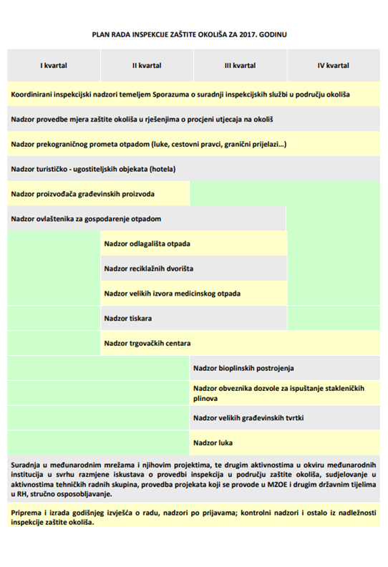
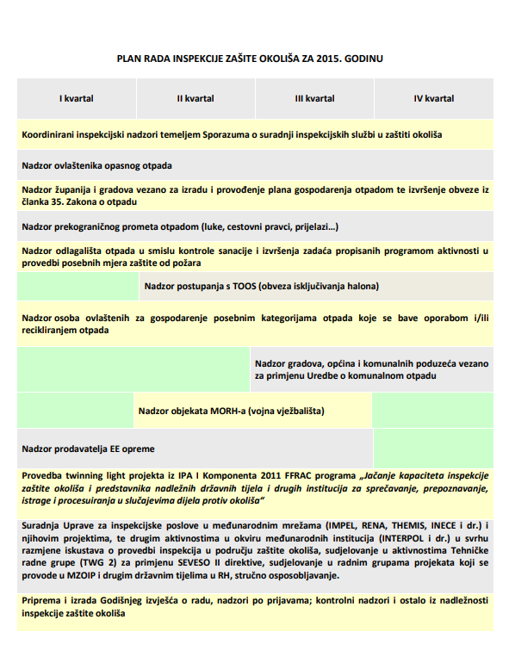
10.5 RMCEI - planning
European Union IPA 2013 Programme for Croatia
Institut za energetiku i zaštitu okoliša
Energy Research and Environmental Protection Institute

Slide 16
10.5 RMCEI - monitoring - EXAMPLES FROM PRACTICE
European Union IPA 2013 Programme for Croatia
On-site monitoring
Each Member State should ensure that the following criteria are always applied in all inspections
to always check the EU regulations relevant to the given monitoring
If more inspectors conduct monitoring, they share all relevant information both from the field and other information
that reports are made about the findings of inspection on the basis of the criteria described in the RMCEI and that they are available to all competent authorities in the territory of the Member State
that inspectors have the legal basis to be provided with access to the monitored operator and to all relevant information
due to non-compliance/ irregularity
Institut za energetiku i zaštitu okoliša
Energy Research and Environmental Protection Institute

Slide 17
10.5 RMCEI - monitoring - EXAMPLES FROM PRACTICE
European Union IPA 2013 Programme for Croatia
What are the types of inspection?
Routine - planned
Unplanned
due to complaints
due to accidents
Due to non-compliance/ irregularity
Institut za energetiku i zaštitu okoliša
Energy Research and Environmental Protection Institute

Slide 18
10.5 RMCEI - monitoring - EXAMPLES FROM PRACTICE
European Union IPA 2013 Programme for Croatia
Planned – routine on-site monitoring
Each Member State should ensure that inspections of controlled plants are regularly carried out as part of routine environmental monitoring and that the following criteria are always applied
during routine monitoring, to re-examine the entire impact of the monitored facility on the environment in the context of the relevant regulation, monitoring programs and in accordance with the organizational aspects of the inspection body
that such monitoring promotes and enhances the knowledge of operators in this area
to assess the effectiveness of the existing permit of the monitored facility in view of its environmental impact and to consider the need to change the permit in the sense of its improvement
Institut za energetiku i zaštitu okoliša
Energy Research and Environmental Protection Institute

Slide 19
10.5 RMCEI - monitoring - EXAMPLES FROM PRACTICE
European Union IPA 2013 Programme for Croatia
Planned - routine on-site monitoring
4.1.6. Supervision of counties and major cities related to air quality monitoring
The purpose of the monitoring was to determine the fulfillment of obligations related to air quality monitoring prescribed by the Air Protection Act.
The work plan envisages monitoring of all counties, the City of Zagreb, 16 major cities and the city of Kutina, and a total of 38 inspections were carried out, i.e. all planned inspections.
In order to overcome the identified irregularities, a total of 25 measures have been given to the record for the elimination of non-compliances related to the development of program for air and ozone layer protection, climate change mitigation and adaptation to climate change, which is an integral part of the environmental protection program. A total of 8 measures were executed, while others did not expire in terms of their deadline for execution.
expiration date expired.
Institut za energetiku i zaštitu okoliša
Energy Research and Environmental Protection Institute

Slide 20
10.5 RMCEI - monitoring - EXAMPLES FROM PRACTICE
European Union IPA 2013 Programme for Croatia
Unplanned on-site monitoring
Each Member State should ensure that unplanned inspections are carried out in the following cases
in serious environmental complaints and as soon as possible after receiving such complaints
in the case of serious accidents and incidents as well as serious inconsistencies with EU regulations, and as soon as possible after such information reaches the inspection body
prior to the commencement of the work of the monitored facility and after issuing a permit therefor to determine whether the operations of the operator comply with the measures and requirements of the permit
for the same reasons when changing the license to a monitored facility
Institut za energetiku i zaštitu okoliša
Energy Research and Environmental Protection Institute

Slide 21
10.5 RMCEI - monitoring - EXAMPLES FROM PRACTICE
European Union IPA 2013 Programme for Croatia
Unplanned on-site monitoring
Citizens’ complaints
During the year 2016, the Environmental Inspection received 1067 complaints, of which, according to the sender’s structure, the largest number were those coming from citizens and anonymous claimants.
Also received were applications from various state bodies, institutions and associations: the Ministry of the Interior, local authority units, other inspections, non-governmental organizations, People’s Ombudsman, the State Attorney's Office, the Office of the President of the Republic of Croatia, the Government of the Republic of Croatia and the Croatian Parliament.
Environmental inspection has acted and implemented the appropriate procedures according to the 911 complaints received, of which 200 were forwarded to other inspection bodies. There were 18 anonymous incomprehensible and unclear complaints that could not be further processed.
Institut za energetiku i zaštitu okoliša
Energy Research and Environmental Protection Institute

Slide 22
10.5 RMCEI - monitoring - EXAMPLES FROM PRACTICE
European Union IPA 2013 Programme for Croatia
Unplanned on-site monitoring
Exceptional circumstances
A special group of unplanned monitoring of environmental inspection consists of extraordinary events. Reports on emergency incidents are received through the State Office for Protection and Rescue - Center 112, information from other competent authorities such as the Ministry of the Interior or the Customs Administration of the Ministry of Finance and by the direct notification of the operator who, under the provisions of the Environmental Protection Act, has a duty to notify the competent authorities without delay on all relevant aspects and measures taken to prevent damage to the environment caused by the performance of their activities or their reduction to the least extent possible.
Institut za energetiku i zaštitu okoliša
Energy Research and Environmental Protection Institute

Slide 23
10.5 RMCEI - monitoring - EXAMPLES FROM PRACTICE
European Union IPA 2013 Programme for Croatia
Unplanned on-site monitoring
Exceptional circumstances
During the year 2016, 37 reports of exceptional circumstances events were received on the basis of which 44 inspections were carried out by environmental inspectors. Of the total of 37 alarms, two alarms had no environmental pollution detected. There was only one unjustified alarm. Of the remaining 34 warnings, 30 cases have an unknown pollutant.
Institut za energetiku i zaštitu okoliša
Energy Research and Environmental Protection Institute

Slide 24
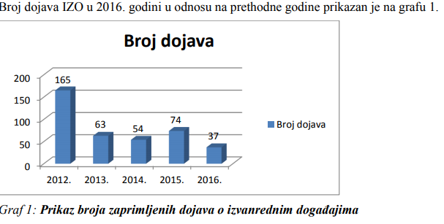
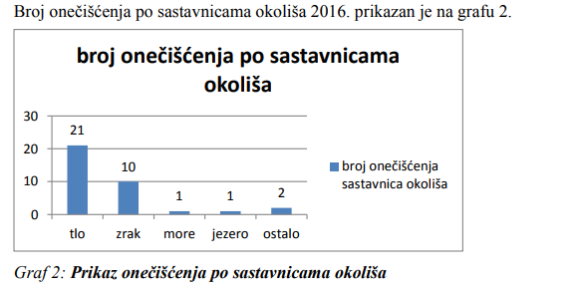
10.5 RMCEI - monitoring - EXAMPLES FROM PRACTICE
European Union IPA 2013 Programme for Croatia
Unplanned on-site monitoring
Institut za energetiku i zaštitu okoliša
Energy Research and Environmental Protection Institute

Slide 25
10.5 RMCEI – reporting on monitoring- EXAMPLES FROM PRACTICE
European Union IPA 2013 Programme for Croatia
Reports and conclusions after on-site monitoring
Each Member State should ensure that, after each inspection on monitoring and the conclusions adopted subsequently, a report is compiled that will be uniquely labeled and recognizable.
The report should contain findings on compliance with the EU regulations for a monitored facility, assessment and conclusions on the need to undertake further procedures (measures to address deficiencies, initiate misdemeanor or criminal proceedings, modify the permit).
It should also contain information on whether there is a need for subsequent inspection.
The report shall be made as soon as possible after monitoring is completed.
Institut za energetiku i zaštitu okoliša
Energy Research and Environmental Protection Institute

Slide 26
10.5 RMCEI - reporting on monitoring- EXAMPLES FROM PRACTICE
European Union IPA 2013 Programme for Croatia
Reports and conclusions after on-site monitoring
Once written, each report should be kept in the available database.
The full report or, if it is not practical, its conclusions, should be delivered to the operator of the supervised plant in accordance with Directive 90/313 / EEC.
The report should be available to the public for up to two months after inspection.
Institut za energetiku i zaštitu okoliša
Energy Research and Environmental Protection Institute

Slide 27
10.5 RMCEI - EXAMPLES FROM PRACTICE
European Union IPA 2013 Programme for Croatia
Investigation (inspection) in cases of serious accidents, incidents and non-compliances
Each Member State should ensure that investigation (monitoring) is carried out by the competent authority in the event of serious accidents, incidents and non-compliances with EU regulations for the purpose
to determine the cause of the event and, if possible, responsibility for the event and to report to the competent authorities (the State Attorney's Office) if necessary
reduce or if possible mitigate the impact of an event on the environment through the determination of measures to be taken by operators or competent bodies
to establish measures to prevent the event from developing further in the negative direction
to initiate a misdemeanor or criminal procedure if necessary as well as to ensure that the operator takes appropriate action
Institut za energetiku i zaštitu okoliša
Energy Research and Environmental Protection Institute

Slide 28
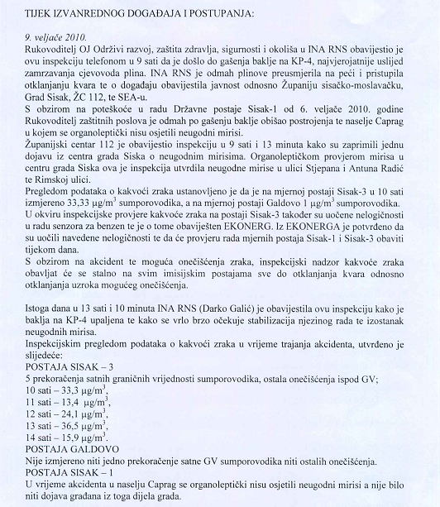
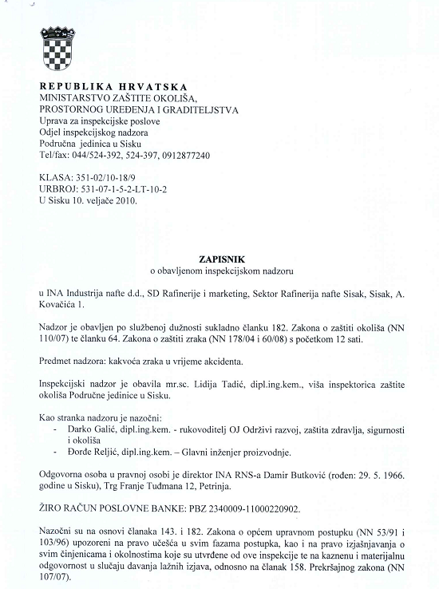
10.5 RMCEI - reporting on monitoring- EXAMPLES FROM PRACTICE
European Union IPA 2013 Programme for Croatia
Institut za energetiku i zaštitu okoliša
Energy Research and Environmental Protection Institute

Slide 29
THANK YOU FOR YOUR ATTENTION
Energy Research and Environmental Protection Institute
Disclaimer: The contents of this publication are the sole responsibility of EKONERG – Energy Research and Environmental Protection Institute, Ltd. and can in no way be taken to reflect the views of the European Union
This project is funded by the European Union

